Slide 1
Did they vote?
Minjung, Preet, Raza, Erika, Robert, Laika

Slide 2
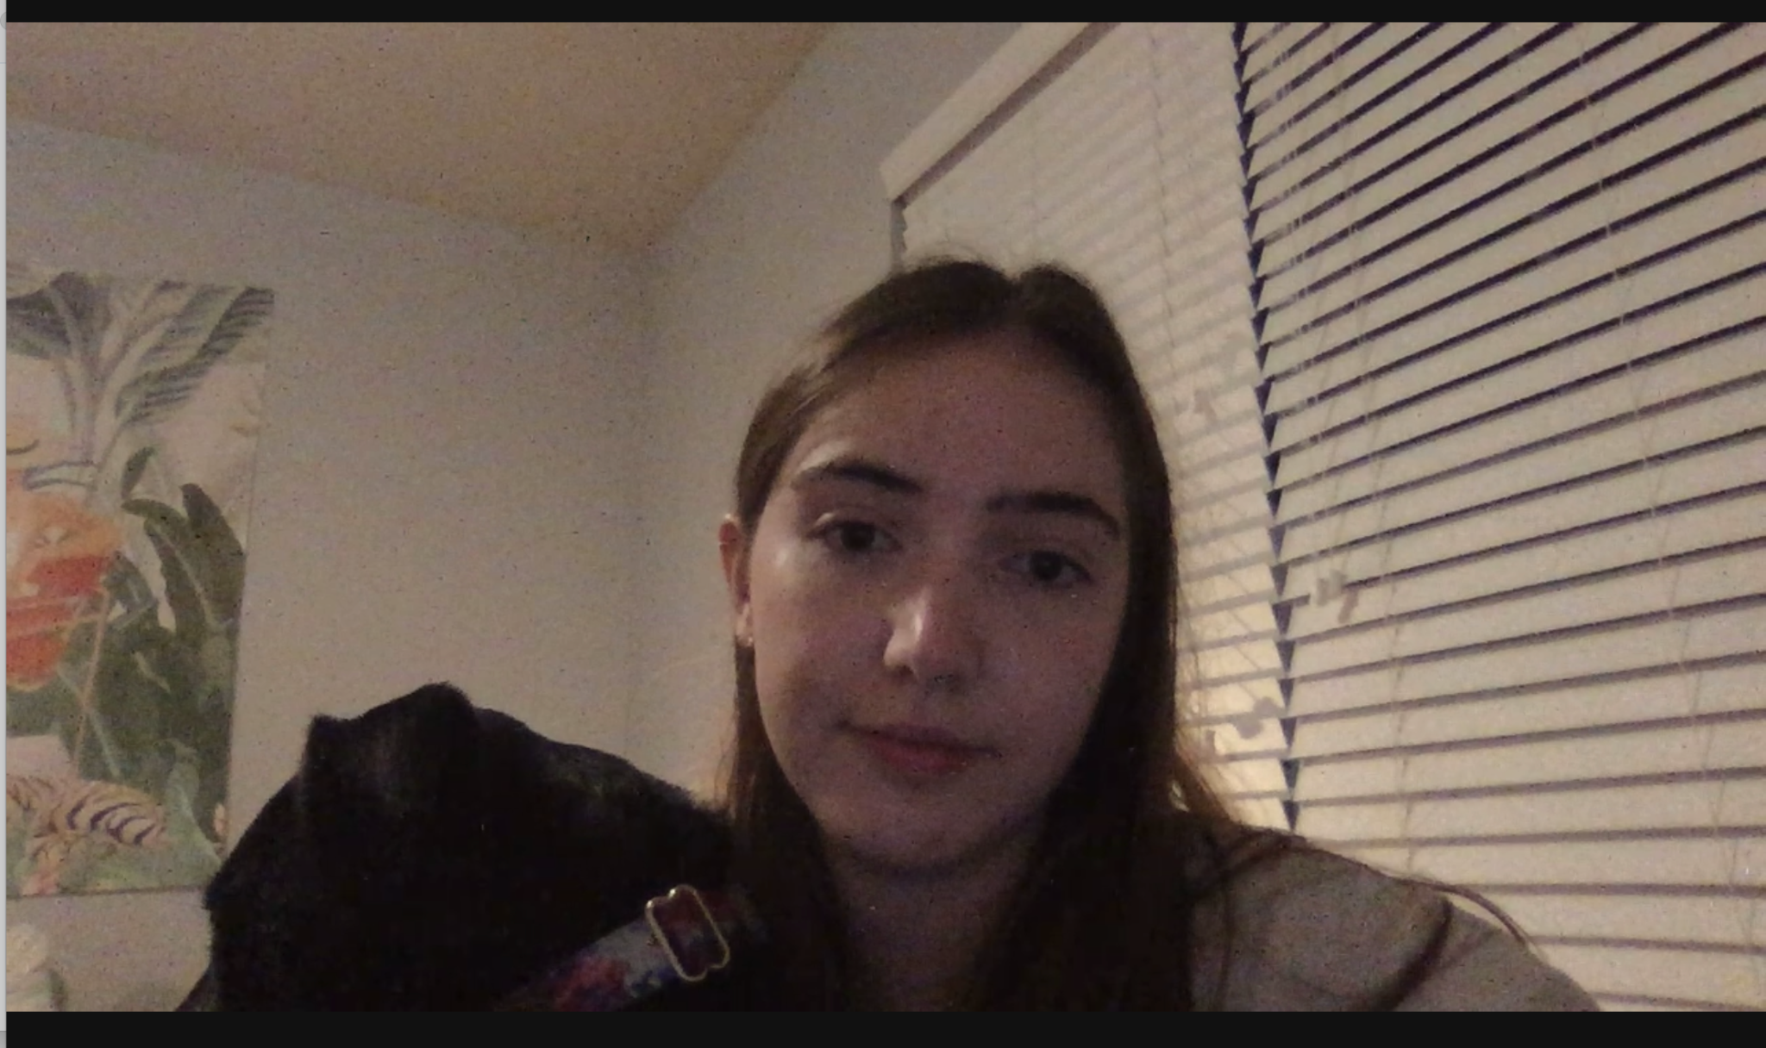
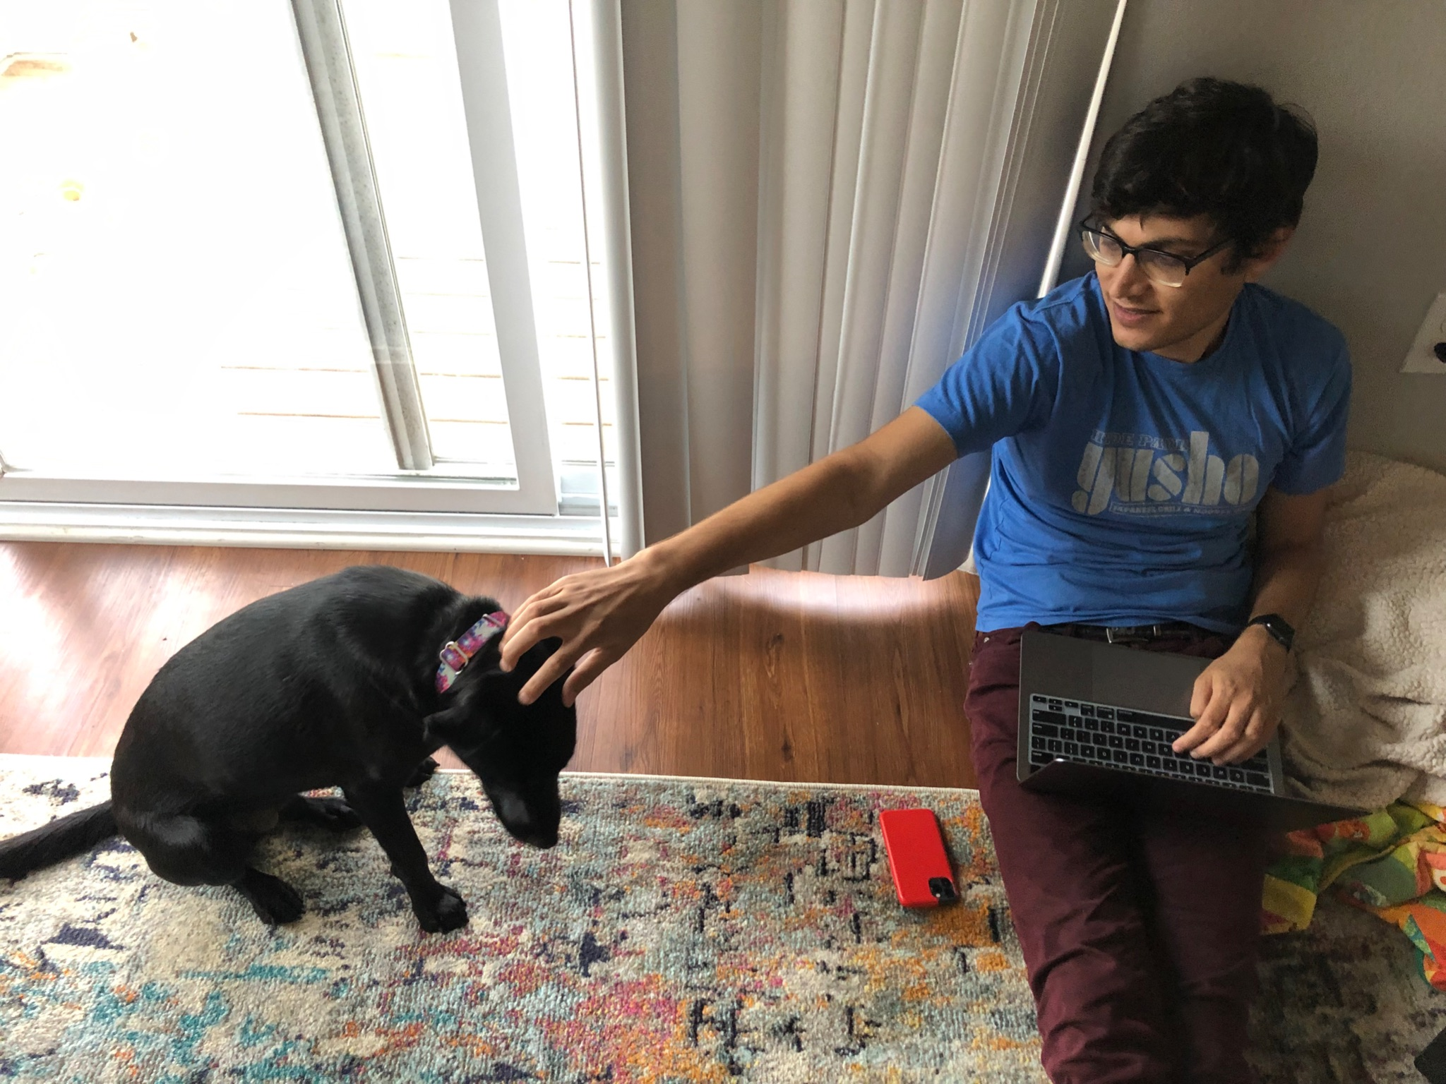
Laika, for reference:

Slide 3
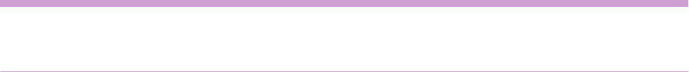
Introduction
This analysis is to identify how different groups voted in the 2020 elections out of those who registered in North Carolina.
Questions of Interest:
How did different demographic subgroups vote in the 2020 general elections?
For example, how did the turnout for males compare to the turnout for females after controlling for other potential predictors?
Did the overall probability or odds of voting differ by county in 2020? Which counties differ the most from other counties?
How did the turnout rates differ between females and males for the different party affiliations?
How did the turnout rates differ between age groups for the different party affiliations?

Slide 4
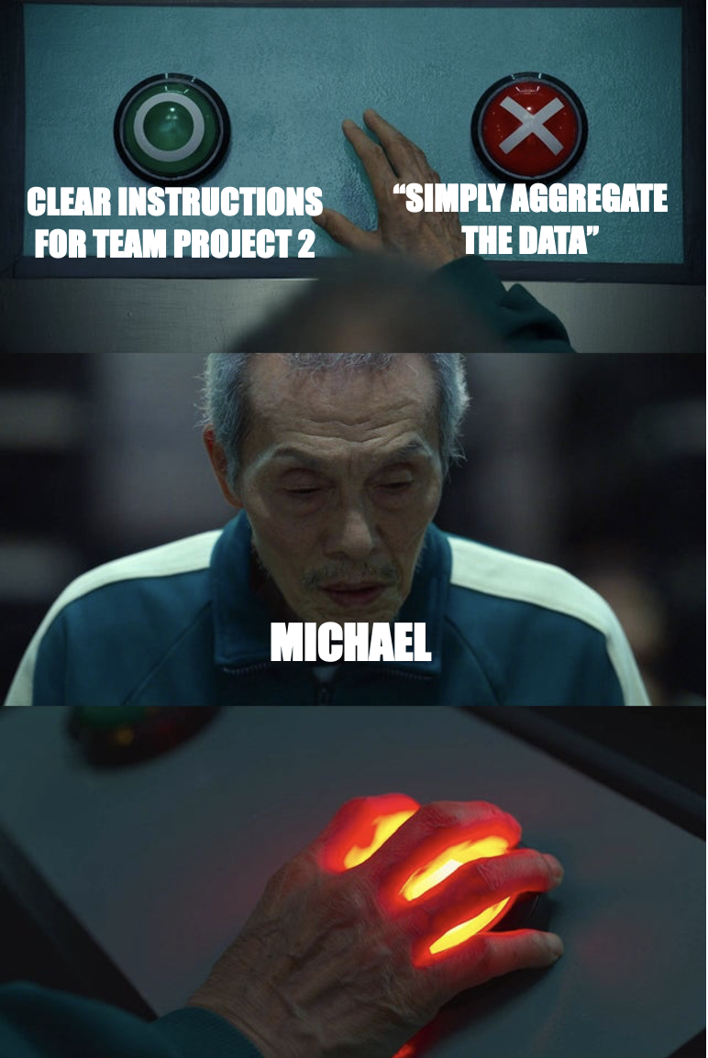
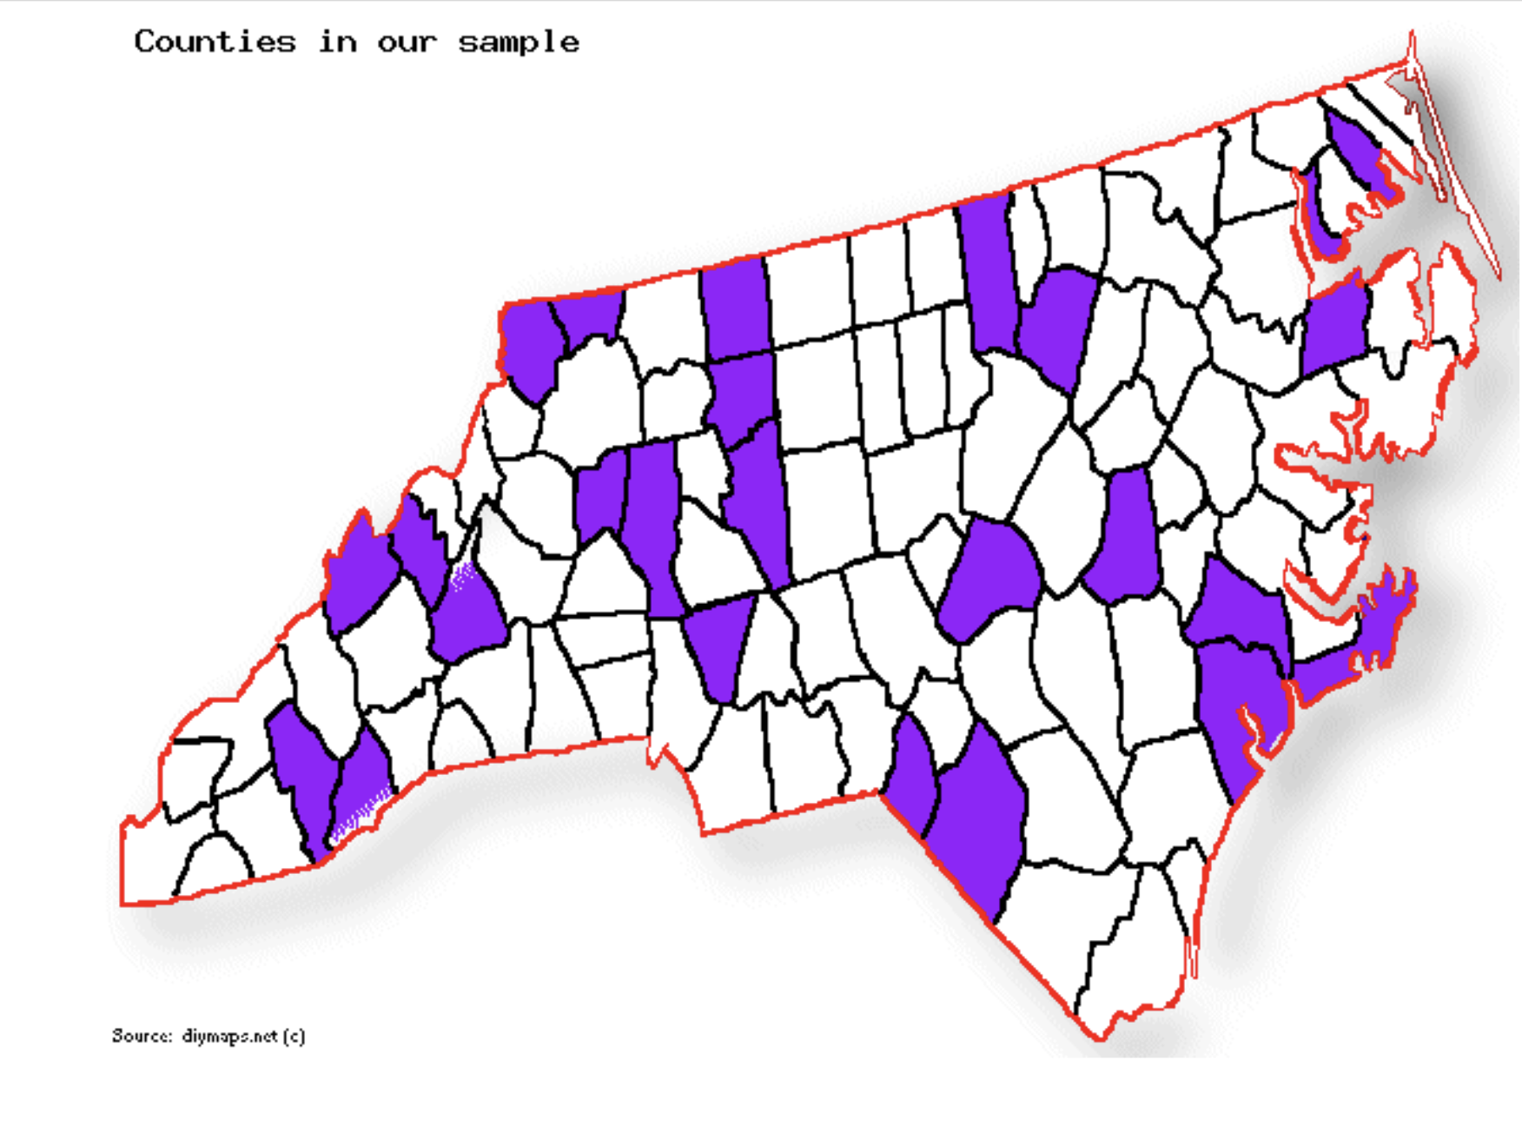
Data
Selected a random sample of 25 counties
Raza

Slide 5
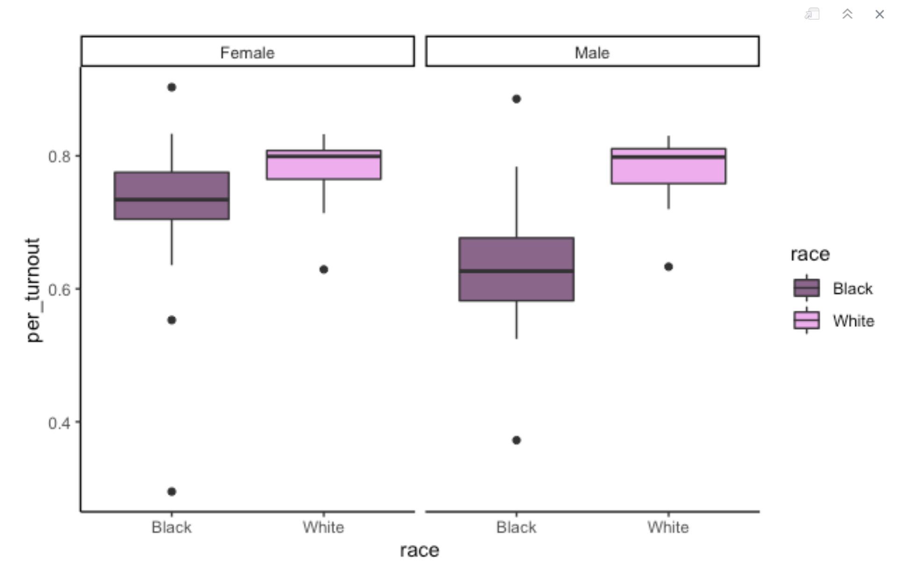
Data
Aggregated datasets to pull county-level counts for turnout and registered voters
Joined two datasets to create a percent turnout variable for EDA
Combined parties with fewer observations - LIB, GRE, CST
Combined races with fewer observations - A, M, P, I, O

Slide 6
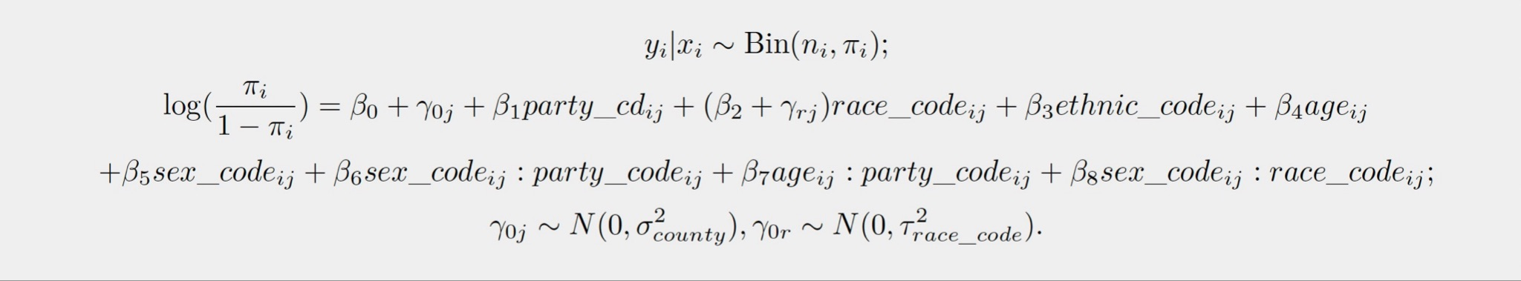
Model

Slide 7
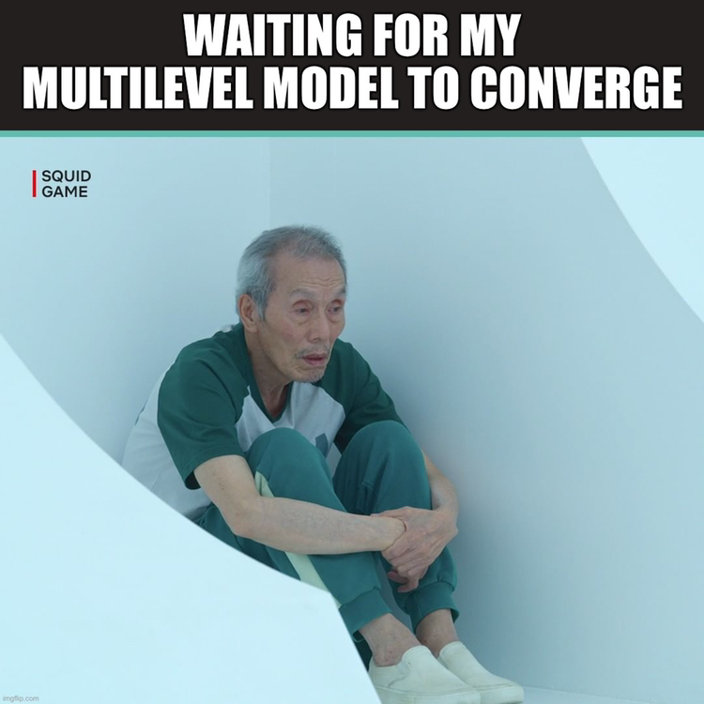
MoDdEl
Robert

Slide 8
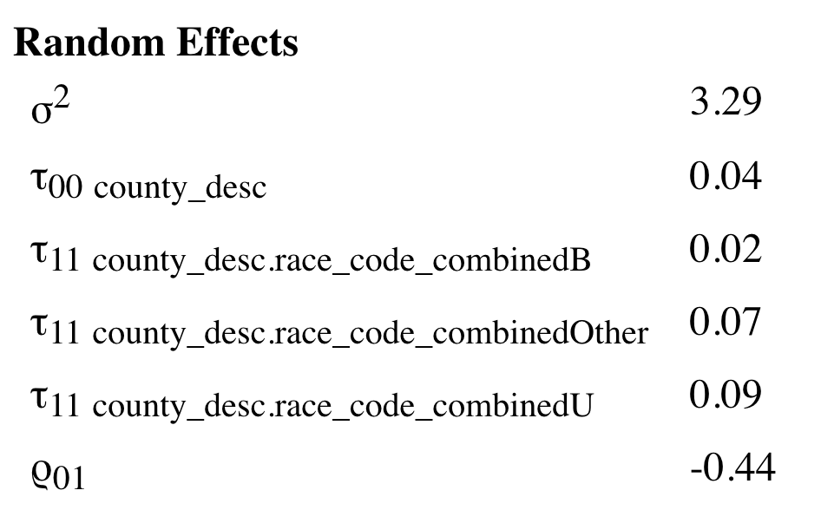
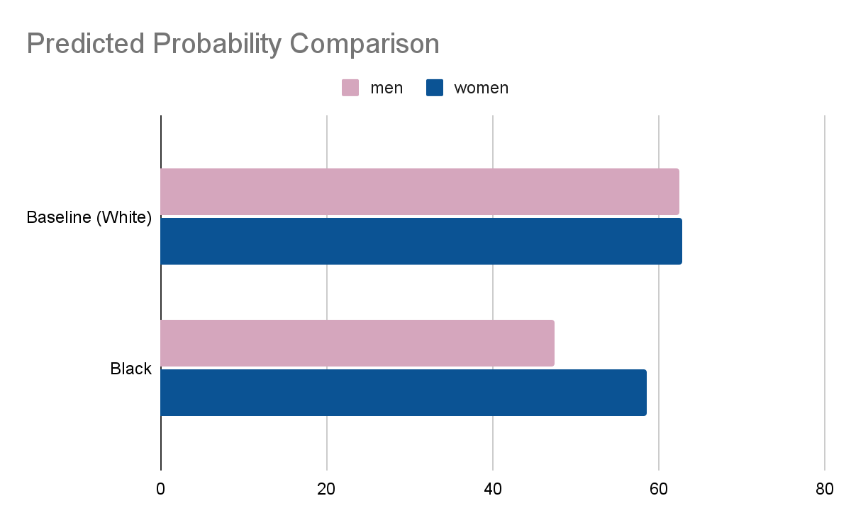
Model
Fixed Effects
Baseline : age 18 - 25, white, not hispanic, female, democratic

Slide 9
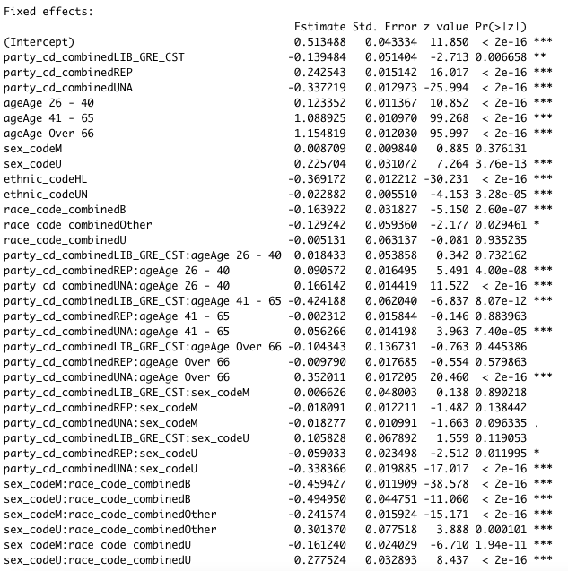

Slide 10
Just Kidding

Slide 11
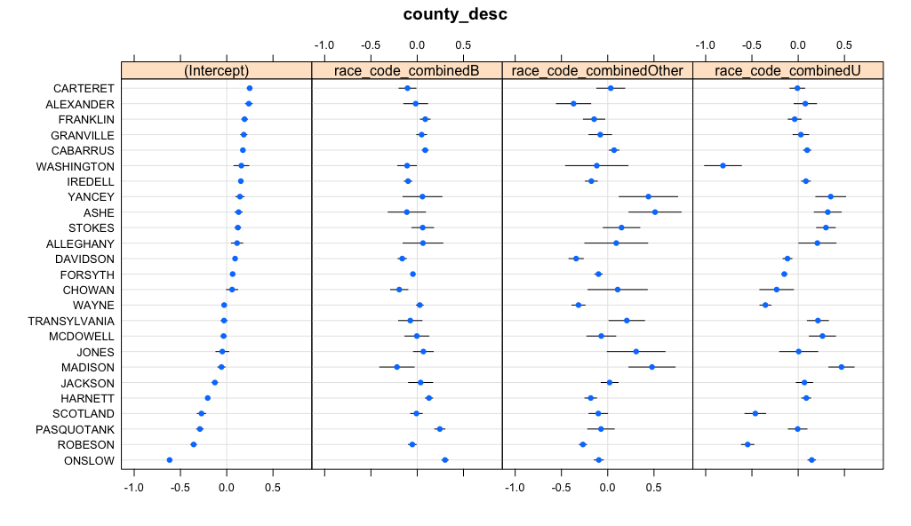
Model - Random Effects

Slide 12
Limitations
Registration data and voting data do not match
Voters are able to change party registration
Voters are able to register same-day
Voters may vote in a different county
Significant number of unknown observations (sex, race, ethnicity)
This analysis only accounts for registered voters, not eligible voters
Specific only to North Carolina

Slide 13
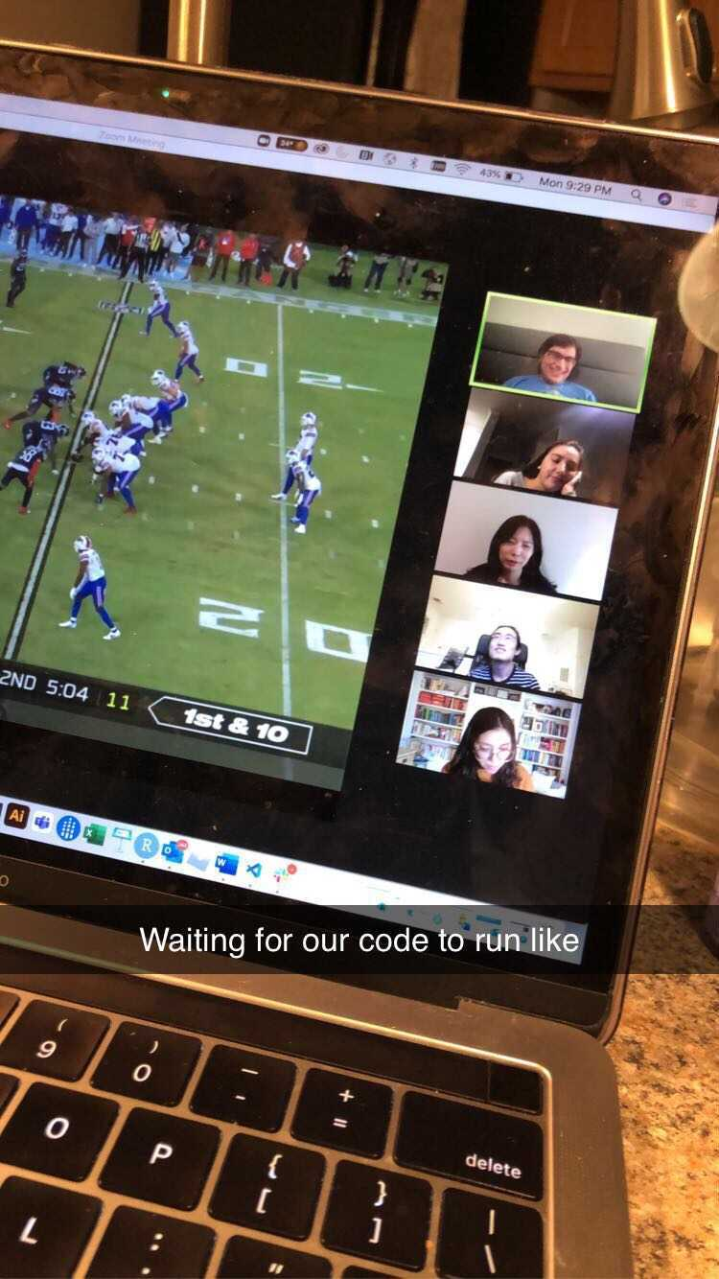
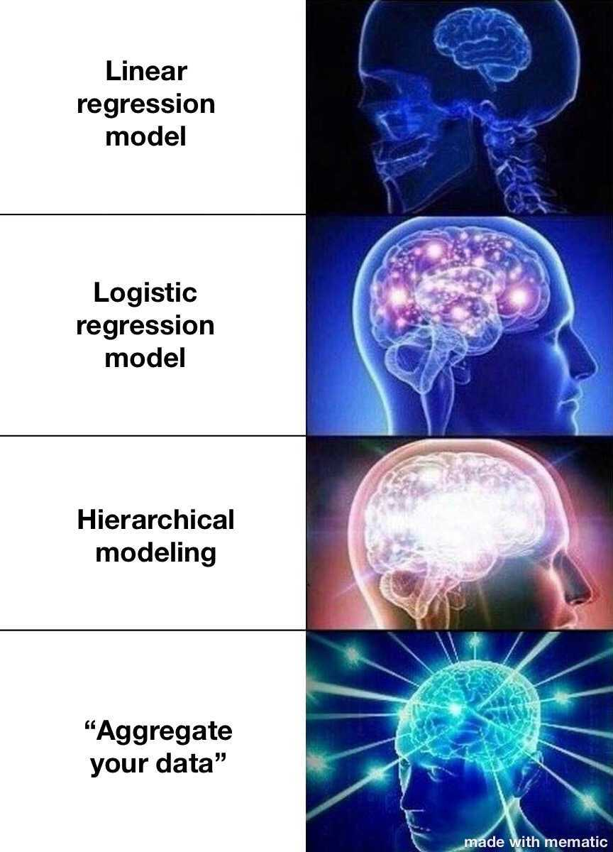

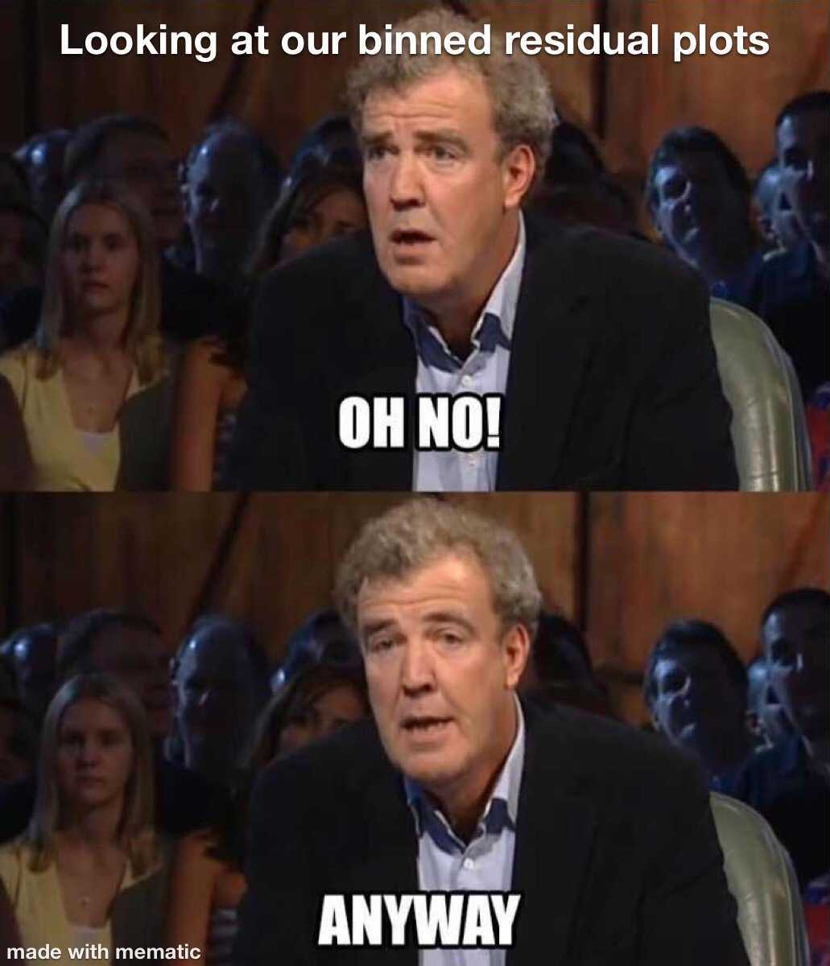
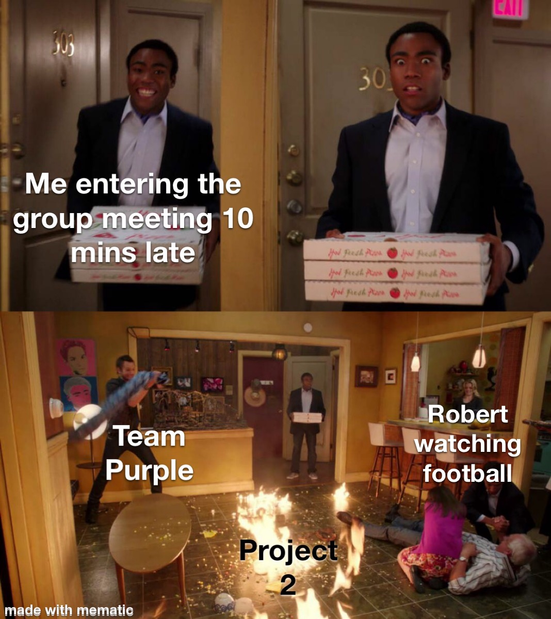
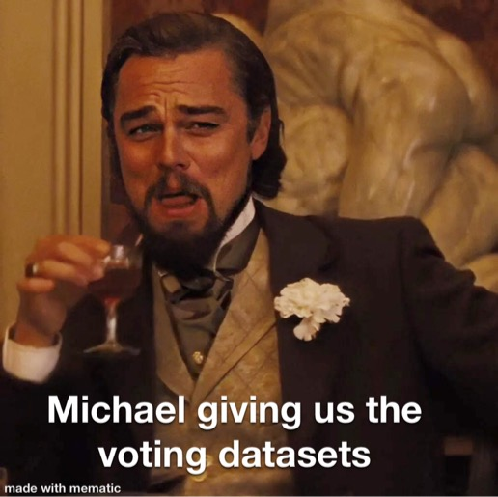
A gallery of 702 memes
Preet
Erika
Erika
Preet
Preet
Preet
Preet

